Slide 1

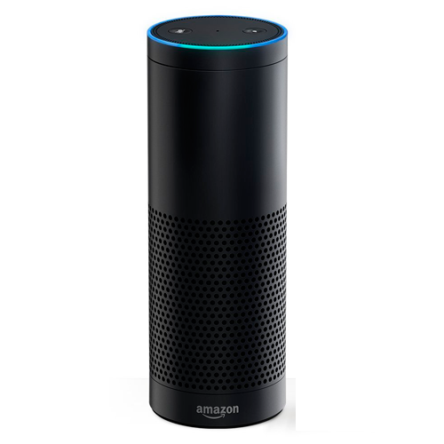






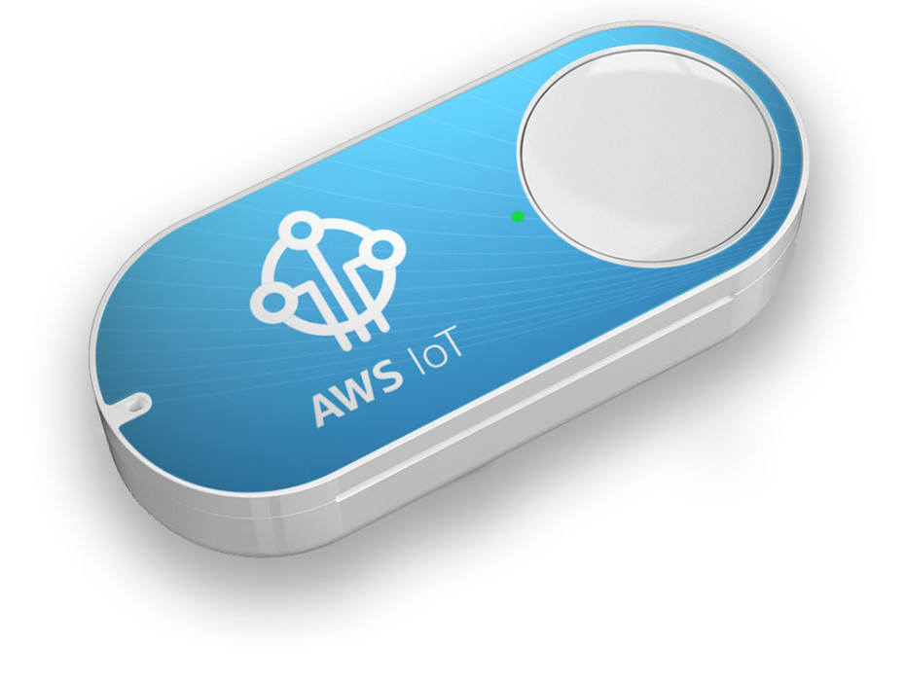


Alexa, test stuff
Alexa, what’s the deployment status
If >80% tests pass, turn GREEN.
Else, turn RED.
Amazon API Gateway
80% tests have passed
Lambda
Code Pipeline
DynamoDB
Lambda
IoT
Single-Click for kick-off deployment
Use Case | Entry Point | Flow | Output
1. Kickoff Deployment | -Amazon Alexa -Amazon IoT Button | Lambda starts Code Pipeline, writes results to Dynamo Lambda listens to Dynamo Trigger, sends to IFTTT REST | -Hue Light
2. Get Deployment Status | -Amazon Alexa | Lambda gets last run from Dynamo | -Amazon Alexa

